Slide 1

Q4U – A year of MA auto
questions and answers

Slide 2
Irene Morrill, CPCU, CIC, ARM, CRM, CRIS, MLIS, LIA, CPIW
VP Technical Affairs, MAIA
imorrill@massagent.com
This program is designed to provide accurate and authoritative information in regard to the subject matter covered. It is provided with the understanding that the publisher is not engaged in rendering legal, accounting, or other professional service. If legal advice or other expert assistance is required, the services of a competent professional person should be sought.
With special thanks to the Insurance Services Office, Inc. and the Automobile Insurers Bureau for advance information, continued support, and permission to use their forms and information.

Slide 3
MAP and long term rental
I was searching for a back issue of Tech-Talk that discusses long term rental car use
The issue is we have a client in Florida who was renting a vehicle in Florida long term for over (30) days
I know the 2016 MAB version describes the exclusion under parts 7 and 9 but I remember specifically there was an issue describing the exclusion.

Slide 4
MAP and long term rental
The MAP – 2016 follows you and household members (the 2008 is similar)

Slide 5
MAP and long term rental

Slide 6
MAP and long term rental
But …under each of the Parts 4,5,6 …there is an exclusion
The following is from Part 5 OBI
It’s exclusions 4 & 5 in Part 4 PD and 5 & 6 in Part 6 MP

Slide 7
MAP and long term rental

Slide 8
MAP and long term rental
I would worry about these exclusions (though harder to find in the discussion of collision and comprehensive) for a rental over 30 days

Slide 9
MAP and long term rental
M-0051S can remove the exclusion from parts 4-9

Slide 10
MAP and long term rental
For the named insured ….
And if household members will be using that vehicle …the exclusion can be removed for them too

Slide 11
MAP and long term rental
The premium for you and HHMs for parts 4,5,6 is 12 or 13 % assuming you are renting a vehicle that has SOME coverage…even state minimum

Slide 12
MAP and long term rental
Coll/comp … a “tad” more expensive
But remember …the insured will ask for the endorsement to be removed when they get home so will only pay for time needed it

Slide 13
MAP and long term rental
FYI ….even the National PAP which some companies use has the same “issue” with long term rental
BI/PD exclusion

Slide 14
MAP and long term rental
FYI ….even the National PAP which some companies use has the same “issue” with long term rental
MP exclusion

Slide 15
MAP and long term rental
FYI ….even the National PAP which some companies use has the same “issue” with long term rental
Coll/comp
Definition of non-owned auto holds exclusion

Slide 16
MAP and long term rental
An endorsement would be needed to remove exclusions
But whether the company uses ISO 2005 or 2018 – only Parts A and B regular use exclusion is removed by the endorsement – NOT Part D …coll/comp

Slide 17
Deferred operator issues
We need clarification regarding a deferred operator. We just learned that our carriers are inconsistent in their approach to handling deferred drivers.
Here’s a situation we came across yesterday:
We have a household with the following people:
Mom
Dad
Kid 1
Kid 2
Kid 3

Slide 18
Deferred operator issues
Mom and dad have 3 vehicles in their name.
All 5 household members are listed operators on the policy.
Kid 1 is purchasing his own car.
We are writing a separate policy with kid 1 as the named insured.
However, we intended to add the remaining 4 members of the household as deferred operators.

Slide 19
Deferred operator issues
We have two carriers who advise us that this is perfectly fine.
However, a 3rd carrier tells us we can’t do this because the policy for the 4 remaining household members has 3 cars and 4 drivers.
Since there is one driver on this policy who is not “rated”, he or she can’t be deferred from Kid 1’s policy.
They want us to add him as an occasional operator.
I’ve never heard of this before.
If this underwriter provided us with accurate information, then we are in big trouble because we’ve been writing all of our policies incorrectly.

Slide 20
Deferred operator issues
Further, I think it’s a huge e & o exposure because rating statuses change frequently.
I can’t a imagine a CSR endorsing all policies in a household every time a rating status changes on another policy in the household .
Can you weigh in?

Slide 21
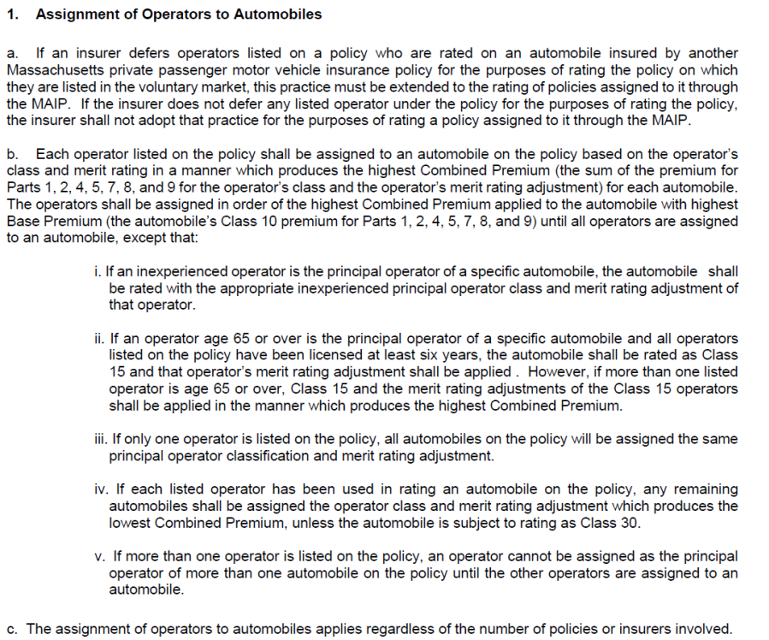
Deferred operator issues
Don’t you just LOVE “competitive auto”!!!
Each carrier can file its own rating procedures – welcome to competitive auto.
MAIP assignment states:
Each carrier must defer an
operator on a MAIP policy
as they would a voluntary
policy
(this kind of tells us that there are various ways of rating …and all are “correct”)

Slide 22
Deferred operator issues
Regarding the parents policy with 3 cars and 3 kids that I “assume” are inexperienced operators – at this point … mom and dad aren’t “ratable” unless their points are outrageous …
Each vehicle would be rated for an inexperienced operator

Slide 23
Deferred operator issues
When Kid 1 gets OWN vehicle … and it is rated for him/her …then that child can be deferred from parents’ policy
There are now 3 cars and 4 potential operator classifications … 2 most expensive cars for 2 occasional kids …and the third least expensive vehicle for worst driver of mom and dad

Slide 24
Deferred operator issues
But …this also says that the occasional operators can be listed on siblings' policy … as occasional operators … but should still be rated for principal inexperienced operator Kid 1
When kid 1 “ceases” to be
an inexperienced operator … well … then classification will change to occasional kid 2 or 3 …
if THIS vehicle creates a higher premium than when kid 2 or 3 on parents' policy

Slide 25
Deferred operator issues
But …each company can have OWN rating rule …
I guess I wouldn’t put the policy(ies) with the company that has the stringent rating/classification rules …
Again …gotta love “competitive auto rating”

Slide 26
Is MAP primary or excess?
I am hoping you can assist me on a claim situation that we are having with Company X.
We have an auto repair shop that has loaner vehicles (like so many now) and they are very diligent about verifying insurance coverage and having the customer sign a rental/loaner agreement while their vehicle is in his shop being repaired.
Their customer got into an accident with the loaner vehicle, and we are expecting Company X, the insurance company for the person that signed the agreement (that was using the vehicle) to pay the collision coverage on a primary basis and not our insured’s company for the repair shop, Utica.
We have had this occur many times and never once had an issue with the customer’s insurance company paying collision on a primary basis due to the definition of your auto and reinforced with the rental/loaner agreement making it clear that their insurance is to be primary.

Slide 27
Is MAP primary or excess?
Company X is the first company in all my years that has kicked back on this.
They started with an excerpt from the property damage liability section of the policy which I pointed out several times was not the proper area for them to be viewing, that they should be looking under the collision section -your auto portion and definition.
It took them a long time to respond and agree/realize they were referring to the wrong section.
Now instead of referring to the upper part of the collision section they are citing this section at the very end which again I think is incorrect. At quick glance I am not exactly sure how to interpret that last paragraph but since it mentions a limit in the coverage selection page, I feel they are not referring to collision coverage.

Slide 28
Is MAP primary or excess?
I am a producer and I have to leave for a meeting and I have been arguing with them for over a week on this and need to resolve this for my client (the auto repair shop) who is upset about this.
Can you jump in on this and assist? I can provide anything needed but I am just rushing a bit at the present time.
I feel strongly that they are not handling and interpreting this correctly and certainly if they were it would create a huge shake-up in the rental and loaner insurance areas including auto body and auto repair shops and how underwriters typically underwrite that risk.

Slide 29
Is MAP primary or excess?
Without looking at the attachment …
I “knew” where they were going. What they sent you has been in the policy for DECADES … why no other company mentioned it.
However, what they DIDN’T say … was what was added to the AIB MAP in 2016 to Parts 5, 7, 8 and 9 as an exclusion:
And the following “general provision” added to the 2016 MAP

Slide 30
Is MAP primary or excess?
Even though this rental vehicle is a “your auto” by definition
Parts 7, 8, 9 all say

Slide 31
Is MAP primary or excess?
Even though a car rented when ours is out of commission is a “your auto” by definition … what that really means is
the “regular use” exclusions don’t apply
anyone can use it with YOUR (named insured’s permission …and owner)
BUT ..it is STILL an auto you do not own … and coverage is meant to be
excess - on ALL the coverage parts …
Part 4 and 5 states:

Slide 32
Is MAP primary or excess?
Part 6 states:
And
Parts 7,8,9 state:

Slide 33
Is MAP primary or excess?
FYI … the MAP is patterned AFTER the ISO PAP …where the issue is the same
Part A liability
Part B MP

Slide 34
Is MAP primary or excess?
Part D – coll/comp and definition of “non-owned auto”
includes “I want to” and “I have to”

Slide 35
Is MAP primary or excess?
FYI … the MAP is patterned AFTER the ISO PAP …where the issue is the same
Part D – coll/comp
Some large auto rental agencies “self insure” – so MAP/PAP would have to drop down …
if there was a major difference in deductible the MAP/PAP would pay the difference …
but it has said for a very long time …”owner’s insurance must pay before we pay”

Slide 36
Is MAP primary or excess?
Agent’s response
Thank you for the response and detail on this, that makes a lot more sense to me as to why traditionally claims were paid from my experience and now this is coming up.
What is very strange though is that for this very same shop,
Company Y just paid a claim in December of 21 on a primary basis as they insured the customer who was provided the loaner.
I know this insured and many other auto body/auto repair shops have had the same occur and the customer’s insurance company paid on a primary basis.

Slide 37
Is MAP primary or excess?
Agent’s response
Perhaps some of the claims adjusters were just adjusting how they had always done and were not aware of this.
Maybe on some of them that date back a little longer the companies were still using the 08 form, not sure.
One comment which I know has nothing to do with you. I don’t understand why companies pick up on a primary basis for large rental companies who self insure physical damage completely or have a very large deductible.
If the garage make the decision to insure that risk it should be handled the same way for them, unfortunate and seems very unfair for the small repair/body and rental shops that can’t take on the risk of self insuring.

Slide 38
Is MAP and limits paid for coll/comp
Also …agent questioned …..
One other question and comment, when it is referred to in the collision section that the owner’s insurance co. must pay up to its limit on the coverage, then we will pay up to the limit shown on your coverage selections page.
What limit(s) are they referring to as almost every MAP issued has no limit per say under collision on the coverage selection page.
Are they talking about the rare agreed or stated value limit and then are they saying they would pay above what you chose for a limit which doesn’t make any sense either.
I am just not understanding that language related to collision.

Slide 39
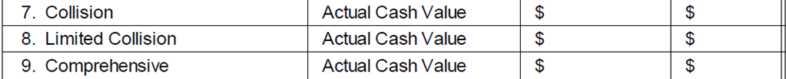
I’m surprised Company Y paid and Company did not …but
But regarding the “limit” paid questions ….
The last MAP Coverage selections page that I was ‘privy’ to …
So the limit for parts 7,8,9 is ACV
If the rental place has a 5000 deductible and the MAP insured had a $500 deductible, then the rental company coll/ comp is primary and the MAP could pay $4500 – the difference in deductibles.
Is MAP and limits paid for coll/comp

Slide 40
Is MAP and limits paid for coll/comp
If the owner of the vehicle does NOT have coll/comp …then the MAP will drop down and pay … ACV

Slide 41
Is MAP and limits paid for coll/comp
International Risk Management Institute says the following re: the PAP language

Slide 42
Business use?
I have a client that operates a Photography School which includes taking the students out on field trips in her mini van.
Would this exposure be excluded under the Private Passenger policy?
Would it be covered under a class 30 or would I need to quote it as livery on a commercial policy?
The majority of the time it is used as her personal vehicle but there are anywhere from 9 to 12 field trips over the term of the classes.
Let me know, thanks,

Slide 43
Business use?
If the client runs the photography school and part of the fee to go to it includes “field trips in the mini van” .. I think that should be class 30 – with wicked high BI limits.
It is a photography training course held during the summer (9 weeks) Monday to Friday for ages 11 to 17. Once in awhile they will travel to various locations around Boston/Salem/Waterfront areas to take photographs and learn different techniques based on the location and objects being photographed. Deb
If the field trips are “part of the photography school fee” then class 30 works
If there is a fee …to defray gas costs …then the MAIP manual …transportation of students or others for a consideration – going to place of school activity endorsement – which has no premium charge … verifies coverage …and it still excludes public or livery

Slide 44
Business use?
If the client runs the photography school and part of the fee to go to it includes “field trips in the mini van”... I think that should be class 30 – with wicked high BI limits.
Agent responded
It is a photography training course held during the summer (9 weeks) Monday to Friday for ages 11 to 17.
Once in awhile they will travel to various locations around Boston/Salem/Waterfront areas to take photographs and learn different techniques based on the location and objects being photographed.

Slide 45
Business use?
The MAIP manual states
It really isn’t “livery” since it’s the SAME bodies all the time …going to the same place together

Slide 46
Uber
I’ve been receiving calls by people who are working for Uber and want high liability (smartly so).
However, it appears that standard carriers do not want to write the policy if it is more that 28 hours/ (needs to be part time).
I’m not sure if a commercial policy would even fit as he is technically not a “business’ but rather an employee.
I am not sure what to do with this one. Obviously, I would like the business, but I am not sure where to place it!

Slide 47
Uber
UBER most certainly is excluded under the MAP the second they “sign into” the app to be available
The is the exclusion in Part 1 …
but there is a similar exclusion in Parts 2,3,4 and a general exclusion for Parts 5-12

Slide 48
Uber
There is no “AIB” endorsement to provide coverage for this exposure. Some companies allow …some don’t … and each has filed their own language.
Most only want to provide coverage for the phase 1 – signed into app but not on way to pick up customer nor has customer in the vehicle.
I agree …they should be with a carrier that will let them insure at LEAST that exposure!!!

Slide 49
Uber
We contacted our “in” at CAR … asking
what or how a CAR servicing carrier would address someone who drives 40 hours per
week or more for UBER since it technically does not qualify for a MAIP carrier since
“public or livery” is not eligible for a MAP
and he said:
Car service class. Send it to the agency’s commercial SC, they handle these risks.

Slide 50
Fault in MA and rental reimbursement
If a customer is found to be 50% at fault, is the other company responsible for 50% of a rental?

Slide 51
Fault in MA and rental reimbursement
On the MA gov’t website …
https://www.mass.gov/info-details/surchargeable-incidents#at-fault-accidents-
At-fault accidents
An accident is defined as a surchargeable at-fault accident if:
The operator is more than 50 percent at fault refer to the Standards of Fault
section below.
The vehicle is a private passenger car
The accident involves a claim payment of more than $1000, in excess of any deductible.
The claim payment is for damage to someone else's property, collision, or limited collision coverages for a vehicle - refer to the Safe Driver Insurance Plan. Bodily injury to others liability claims may be subject to surcharge.

Slide 52
Fault in MA and rental reimbursement
Yes.
If someone is 50% or less at fault they can sue the other party and receive that part of damages that they are not at fault if a Massachusetts claim. Having said that some companies are more “user friendly” on a third-party claim than others.
On a legal website:
Massachusetts uses the 51 percent comparative negligence rule, which is similar to several other states. Under the rule, plaintiffs can only recover if their share of the blame was less than 51 percent. If plaintiffs are 51 percent or more at fault, then they cannot recover at all, with only a few exceptions.

Slide 53
Legal cancellation
My insured's policy renewed on 12/21/2021 and went into cancellation 12/27/2021 for 1/19/2022.
She was involved in an accident on 1/7/2022.
She never made a payment on the cancellation and the insurance company cancelled back to the renewal date 12/21/2021. Would this be a covered loss?
(personal auto policy)

Slide 54
Legal cancellation
The MAP requires a 45-day notice of non-renewal
If certificate of mailing has not been sent 45 days prior to policy renewal date then the policy MUST be renewed
Obviously, this was not done …so policy was renewed

Slide 55
Legal cancellation
Once renewed …then the policy must be legally cancelled …
Certainly …non-payment is a valid reason
The AIB policy states:
AIB policy also states:
20 days notice required sent certificate of mailing

Slide 56
Legal cancellation
So … the policy renewal date was 12/21/2021 –
Cancellation notice sent 12/27/2021
To be effective 1/19/2022….which is a few more than 20 days …which most companies do for mailing notice days
If the accident was on 1/7/22 …the policy WAS IN FORCE and the company MUST respond …
If the company “chooses” to make a journal entry back to the policy effective date to clear their books …they can do that …but they MUST PAY THIS CLAIM

Slide 57
Legal cancellation
SO …yes the company is paying that loss …
if they say no …
then your insured WILL make a complaint to BOTH the attorney general’s office as well as the MA DOI …and see what happens to THAT company
https://www.mass.gov/how-to/file-a-consumer-complaint
https://www.mass.gov/how-to/filing-an-insurance-complaint
The first website online complaint is the attorney general’s office
The second is the MA Division of insurance

Slide 58
Garaging address – when to change
We have found from our underwriter at Company X that place of garaging does not need to be changed on a policy unless it is a permanent change.
Example snowbirds or kids that take cars with them to college, because
this is not permanent we do not have to change place of garaging anymore??
I have checked with a few of our other companies and they say YES you do?
Would you know which is correct?

Slide 59
Garaging address – when to change
Or is this something each carrier can choose to do or not?
I was always under the impression the vehicle must be rated by the principal place of garaging?
Just confused.
Any info you could share would be helpful.

Slide 60
Garaging address – when to change
It is both a possibility that a company can write its own rules …and then …there is the possibility that companies can interpret the same rule …differently
The MAIP rule is:

Slide 61
Garaging address – when to change
If kid goes to college in August … and brings car …and comes home in the Spring … this rule can be interpreted …GOOD OR BAD …that the garaging should be college …until the kid is graduated …

Slide 62
Garaging address – when to change
If college is “cheaper territory” …then we love that interpretation …if college is a more expensive territory, then we do NOT like that interpretation.

Slide 63
Garaging address – when to change
Snowbirds …should they be out-of-state territory …if live THERE …more than live in MA …and will continue to do this?

Slide 64
Garaging address – when to change
You need to know how each company interprets “correct garaging” …or claims could be denied under False Information

Slide 65

Renting an RV …what coverages follow
Hi I have an insured, who is renting an RV , would their auto insurance cover that?

Slide 66
Renting an RV …what coverages follow
The MAP follows you and HHMs when using an auto for various coverages
An RV …is an “auto” because it is a land motor vehicle and would be subject to motor vehicle registration

Slide 67
Renting an RV …what coverages follow
Parts 4,5,6 talk about “auto”

Slide 68
Renting an RV …what coverages follow
Parts 4,5,6 talk about “auto”
AIB says it MUCH better under Part 5 than Part 4 in the 2016 MAP … but the issue is that the MAP follows you and HHM when using an “auto” – an RV is an auto

Slide 69
Renting an RV …what coverages follow
Parts 4,5,6 talk about “auto”
Part 6 says …occupying any auto …which an RV is

Slide 70
Renting an RV …what coverages follow
Parts 4,5,6 talk about “auto”
Part 6 says …occupying any auto …which an RV is

Slide 71
Renting an RV …what coverages follow
Parts 7,9 only discuss “other private passenger autos”

Slide 72
Renting an RV …what coverages follow
So …parts 4,5,6 can follow
For Parts 7,8,9 – you need to know how YOUR company defines “private passenger auto”
If they define it as cars, pickups and vans …you have a problem ….
If they only define it as cars …you have a problem
“private passenger auto” is not in dictionary.com

Slide 73
Excluding household member
One of my clients lets his daughter drive a company vehicle for her regular use and insured under a commercial auto policy in the Business name.
He wants to exclude her as a driver on his brand new LandRover (only vehicle on policy) that is insured on a personal auto policy.
Would you suggest adding the use of other Autos M-0051-S to the personal policy to cover the daughter in the event she gets sued personally for a vehicle accident?
I guess I'm confused when to add this M-0051-S endorsement. Seems to be coming up a lot lately

Slide 74
Excluding household member
I asked
Is the daughter a listed operator on the family MA personal auto policy …for ANY vehicle?
And the answer …
…
There is only 1 vehicle on the personal policy with Company X. It is a brand-new Land Rover that the clients want to exclude her from driving.
Not sure if you can even add the “driver other car” for her if she’s excluded on the only vehicle listed on the policy.

Slide 75
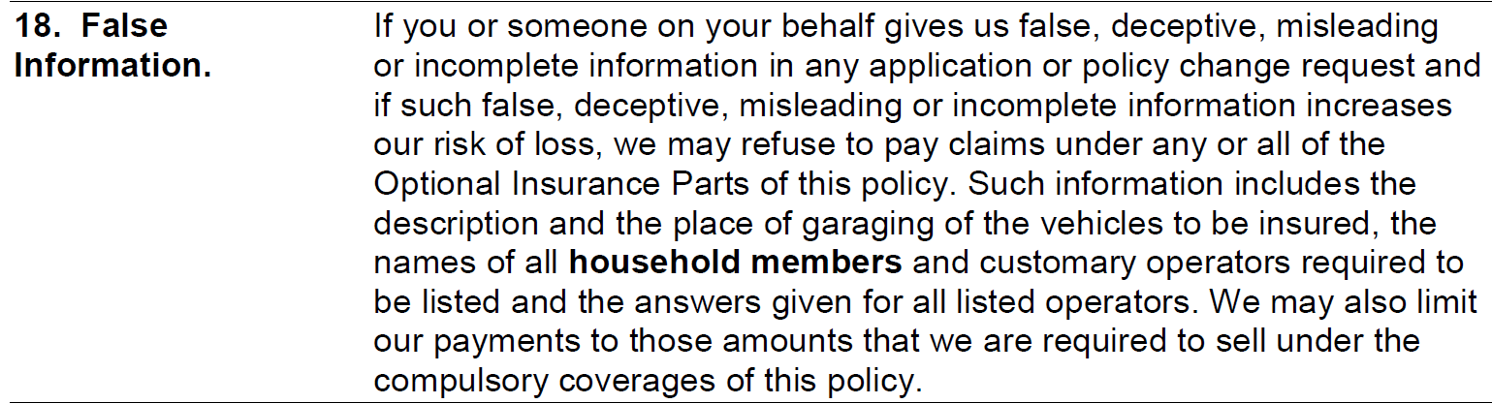
Excluding household member
The “use of other auto” endorsement would be for someone who is a listed operator on a MAP …and they regularly use a “non-owned auto” -which is what is done here …
but I “assume” the commercial policy listing her driving a commercially insured vehicle is in the “control” of Dad …so policy premiums get paid. The BAP covers her when she is in THAT vehicle. The BAP does not “follow” her as a MAP would
If she isn’t a listed operator on family personal auto vehicle, then the General Provision 18 – Failure to furnish provision would apply

Slide 76
Excluding household member
A MAP normally “follows” a household member but since she isn’t mentioned then this could be a problem with the family MAP giving her any coverage – per the Failure to Furnish Information Provision
If she is “excluded” … then perhaps on an “if any basis” when she is driving a vehicle, she does not own …and NOT driving it regularly ….
the Operator Exclusion endorsement M-0106-s could provide coverage for THAT situation
There are two AIB versions …2017 and 2008

Slide 77
Operator Exclusion Endorsement - 2017
2017 edition
Company/named insured/ excluded operator all “AGREE” that excluded
Operator not drive
vehicles excluded from
replacements of these autos
Replacement – vehicle change
temporary substitute

Slide 78
Operator Exclusion Endorsement - 2017
Policyholder and excluded operator
“understand” and agree that company
WILL NOT PAY optional insurance parts
If excluded operator uses described vehicle

Slide 79
Operator Exclusion Endorsement - 2017
Policy holder and excluded operator agree that it endorsement stays on policy UNTIL …policyholder or excluded operator request it off
NOT carrier’s fault if excluded operator is now a class 10 code 99 and SOMEBODY forget to remove the endorsement ….

Slide 80
Operator Exclusion Endorsement – 2017
What if policyholder “you” purchased
$250,000 Part 4 – will all that limit
Apply??
What if excluded operator rents a car for a week while on vacation – he IS a household member still???

Slide 81
Operator Exclusion Endorsement - 2008
2008 version
Beginning essentially the same as 2017
version just no discussion of “agreement”
by policyholder, excluded operator and
company
Not drive excluded vehicle or
Any replacement of it

Slide 82
Operator Exclusion Endorsement - 2008
Next paragraph is essentially General Provision 18
MAY deny all optional coverage
Restrict Parts 3 and 4 to what required
to sell (mandatory limits)

Slide 83
Operator Exclusion Endorsement - 2008
This paragraph is found in Parts 7 Collision and 8 Limited Collision – language from
MGL 90 regarding compulsory limits

Slide 84
Operator Exclusion Endorsement - 2008
No discussion of whose responsibility it is
to remove endorsement from policy
But is there a better argument that family
member is now class 10 code 99 and is not
really an “increased risk of loss”
What if policyholder “you” purchased
$250,000 Part 4 – will all that limit
Apply??
What if excluded operator rents a car for a week while on vacation – he IS a household member still???

Slide 85
Operator Exclusion Endorsement -
Even if the operator exclusion endorsement follows the excluded
operator when he/she drives a non-owned vehicle …
it would NOT follow in THIS situation of excluded daughter regularly
driving a company car – because as previously discussed …
the MAP excludes “regular use of non-owned auto” by you or
household member

Slide 86
Back to the excluded operator
If one wants a “guarantee” that the excluded household member will have
His/her own coverage when drive a non-owned vehicle …
Then a Named Non-owner policy is best
It is the national PAP with the Named non-owner endorsement PP 03 22
endorsement on it
the 2005 version only allows BI/PD/MP/UM/UIM
the 2018 version also allows coll/comp

Slide 87
Auto Rental issues
My husband’s vehicle was hit in a parking lot and he brought it in to be repaired.
He went through the other party’s insurance (Company X).
The Company’s collision center set up his rental and told Enterprise to give him a
comparable vehicle. When he went to Enterprise they gave him 2 options fairly comparable
to his vehicle and didn’t mention the price.
He just picked up his car today (2 weeks later) and Enterprise told him Company X would
only cover $29/day for the rental and they were not going to cover anything else.
My husband was never told they wouldn’t pay higher than $29/day.

Slide 88
Auto Rental issues
He spoke to the claims rep at Company X and they told him they are only required by law to
cover $19/day but were doing him a favor and covering $29/day.
If he was hit by the other party and he is going through their insurance directly,
shouldn’t he have a rental comparable to his current vehicle and they cover the
appropriate cost?
What should he do?

Slide 89
Auto Rental issues
So …when you say “parking lot” …
was your insured parked and hit …
or moving and hit.
If your insured was “moving”…even though the other vehicle might be MORE at fault your insured would still have SOME fault …and then Company X would only be responsible for the % of daily rate that their insured was at fault.
If your insured was parked, then they are 100% responsible for entire cost.
Either way see attached letter written by a former Lawyer for MA DOI citing a MA COURT CASE that said “comparable vehicle” was due and a federal law also says same.
Agent responded
He was parked, inside a store and the vehicle next to him scrapped the side of his car when they were pulling out of the spot.

Slide 90
Auto Rental issues
When your insured is the victim in an accident and needs to approach the “at fault” party for car rental expenses …what can your insured expect?
Part 4 pays
Damage to, loss of use of and sales tax
When legally responsible

Slide 91
Auto Rental issues
The legal theory is “comparable” vehicle
MA court case ANTOKOL v. Barber 248 Mass 393 148 N.E. 350
USA general rule 8 AM Jur 2d Automobiles & Highway Traffic s.1315
MA is a comparative fault state so one can only collect that amount they are NOT at fault
MA surcharges are based on 211 CMR 74 Standards of fault
Fault assignment for purposes of SDIP assignment is 51% or
more

Slide 92
Auto Rental issues
Court assignment for damages is based on rules of the road
MGL 231 s. 95

Slide 93
Legal theory for comparable vehicle

Slide 94
Auto Rental issues
Carrier should not restrict to $ value they think is appropriate
Claimant should research multiple rental places for comparable values

Slide 95
Auto Rental issues
Since Company X sent your client … then they should be stuck with the entire charge.
Company X should have been more specific with Enterprise
Tell the client to make a consumer complaint …it’s free and I wonder if when Company X gets the notice from MA DOI they will just pay the difference.
https://www.mass.gov/how-to/file-a-consumer-complaint
Might mention that lying about a law that states $19.00 a day when there is NONE …might be something the press might like to hear about …as well as the MA DOI

Slide 96
Thank you for attending…
Thank you for attending…
Q4U – A year of MA auto
Questions and answers
If you have any questions, please email imorrill@massagent.com

